Slide 1

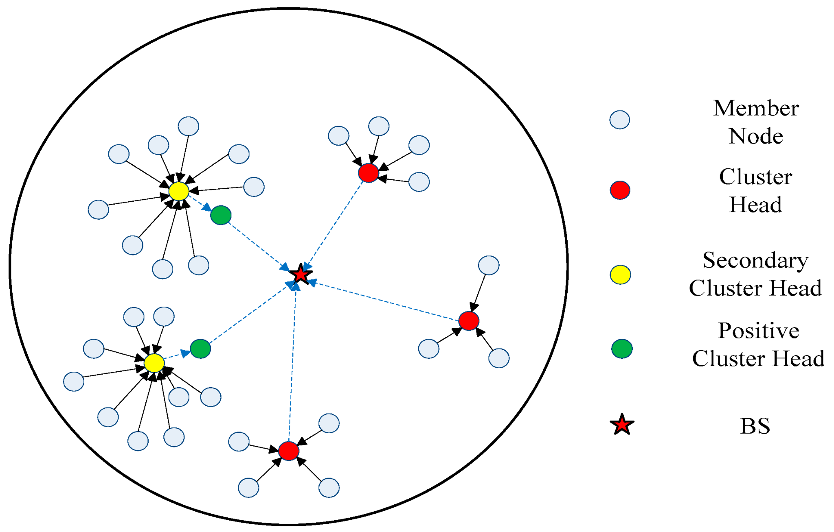
MAJOR PROJECT
Batch-B8
Sensor Network Optimization To Maximize Coverage using Modern Algorithms
Project Team
V.Nikhil(20BQ1A4953)
Sk.Nadeemulla(20BQ1A4946)
A.Chetan(20BQ1A4902)
Project Guide
Dr. Chintalapudi V Suresh
Professor(IOT) .

Slide 2
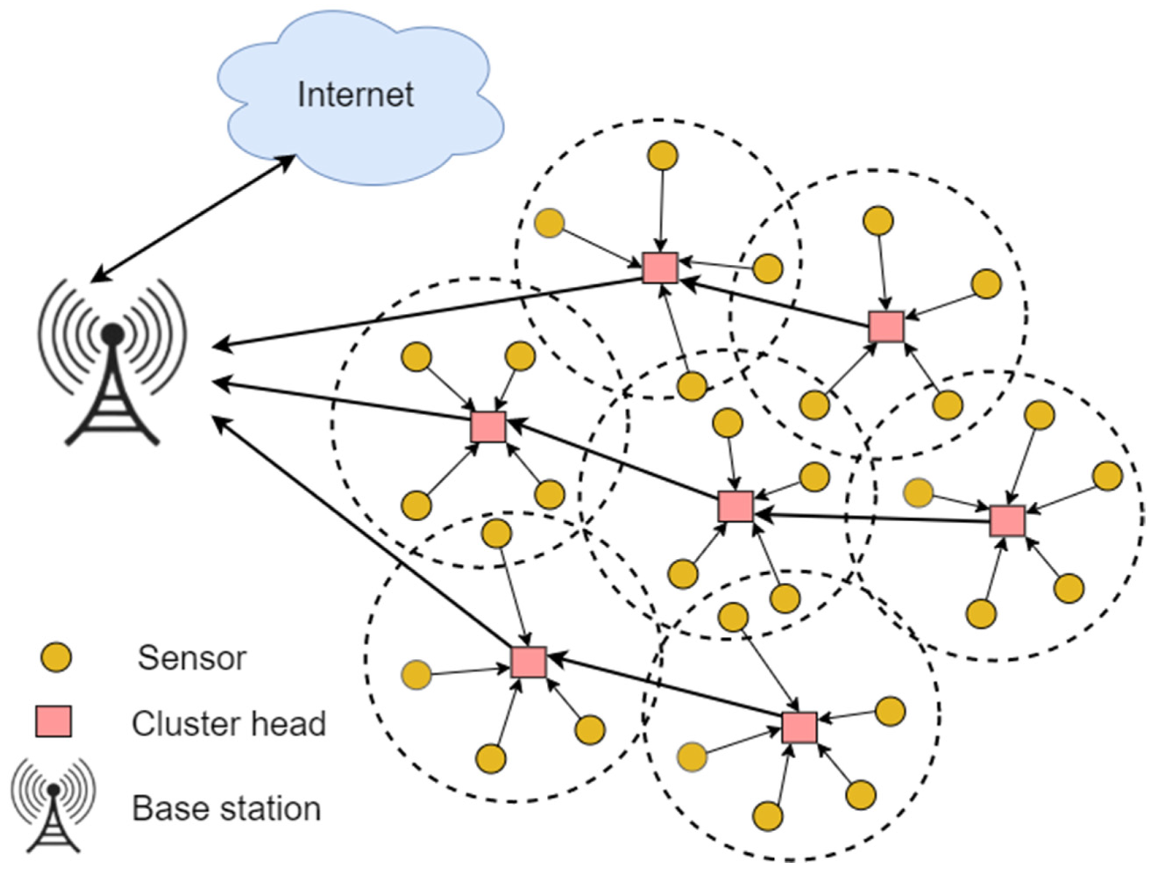
Introduction to Wireless Sensor Network Optimization:
Sensor networks are used to collect and transmit data from various sources.Optimization of sensor networks aims to improve the performance and efficiency of these networks.
Efficient sensor networks can lead to better data collection, reduced energy consumption, and extended network lifetime.
Sensor networks play a crucial role in collecting data from the physical world for various applications such as environmental monitoring, healthcare, and infrastructure management.
Importance of optimization:
Maximizes coverage area while minimizing redundancy.
Enhances sensor network performance and reliability.
Improves resource utilization and prolongs sensor lifespan.

Slide 3
Purpose of Our Project :
The purpose of this project is to explore and implement optimization techniques, specifically using the Particle Swarm Optimization (PSO) algorithm and random coordinate generation, to optimize the deployment of sensors within a network.
Utilize random coordinate generation for sensor placement.
Optimize sensor positions and coverage areas within the network.
Improve performance and effectiveness of the sensor network.
Objectives :
Identify optimal positions for sensor deployment to maximize coverage area.
Minimize redundancy and overlap between sensor coverage areas to conserve resources.
Enhance the reliability and accuracy of the sensor network in detecting and monitoring events .
Explore the effectiveness of PSO algorithm and random coordinate generation in optimizing sensor deployment.

Slide 4
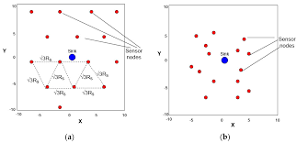
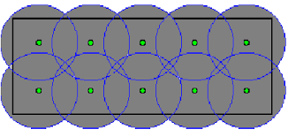
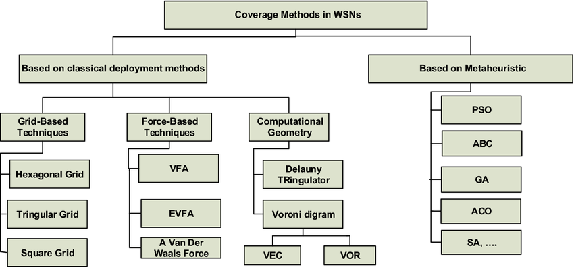
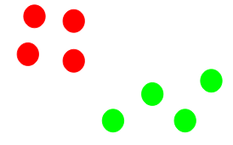
Previous Works :
Random Placement
Grid Placement
K-Means Clustering

Slide 5
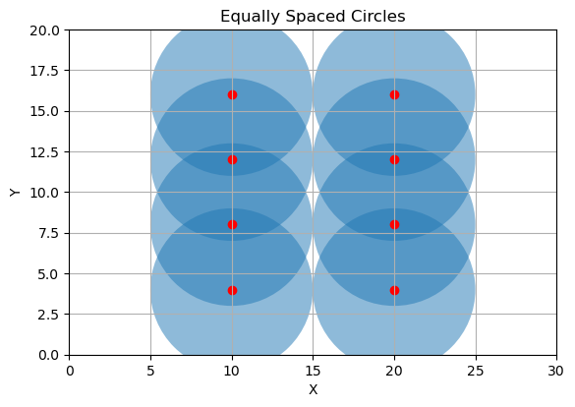
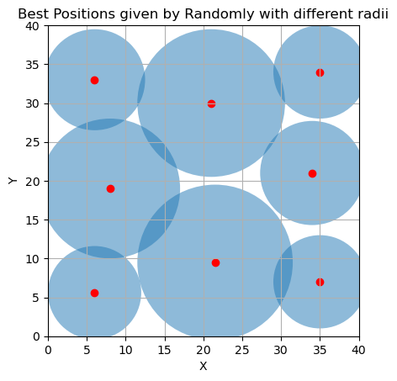
Importance of Using Sensor Tuning :
Area Coverage
Overlap
Random Generation
Optimization Effort
Coverage Flexibility
Computational Complexity
Coordinates of sensors:
Sensor 1: (6, 5.6) ,6
Sensor 2: (21.5, 9.5) ,10
Sensor 3: (35, 7) ,6
Sensor 4: (21, 30) ,9.5
Sensor 5: (6, 33) ,6.5
Sensor 6: (35, 34) ,6
Sensor 7: (8, 19) ,9
Sensor 8: (34, 21) ,6.7
Total area of the region: 1600
Total area covered by circles: 1465.2073977077434
Total area uncovered by circles: 134.79260229225656
No.of Sensors:8
Coordinates of sensors with fixe Radius:
Sensor 1: (10.0, 4.0)
Sensor 2: (10.0, 8.0)
Sensor 3: (10.0, 12.0)
Sensor 4: (10.0, 16.0)
Sensor 5: (20.0, 4.0)
Sensor 6: (20.0, 8.0)
Sensor 7: (20.0, 12.0)
Sensor 8: (20.0, 16.0)
Total area: 600
Total area covered by circles: 628.3185307179587

Slide 6
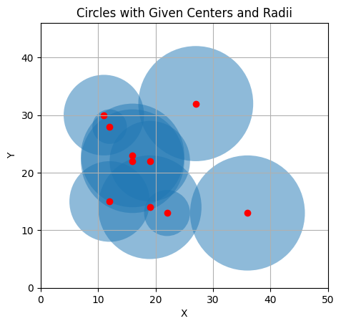
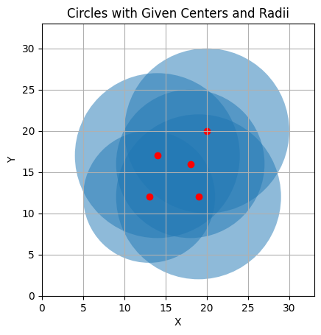
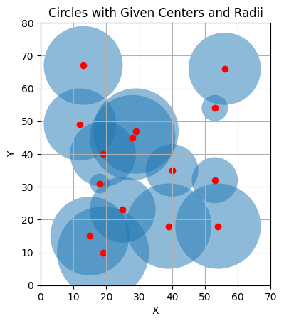
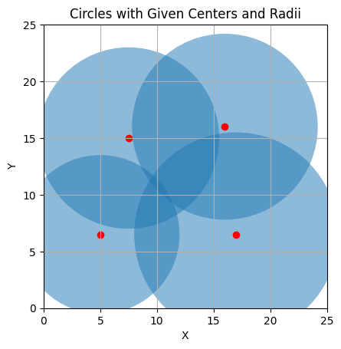
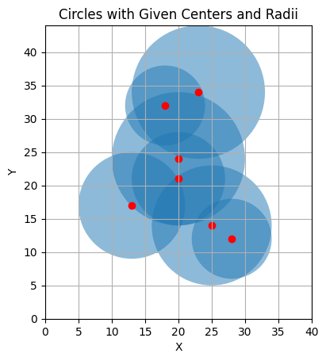
Manual Sensor Placement Process:
The manual code generates sensor coordinates randomly within the specified length and breadth of the area.
Additionally, random radii are assigned to each sensor to define their coverage area.
Limitations :
Relies on random generation, which may not always result in optimal sensor placements.
May not scale well for large-scale sensor networks.
Lacks the ability to systematically optimize sensor positions for maximum coverage.

Slide 7
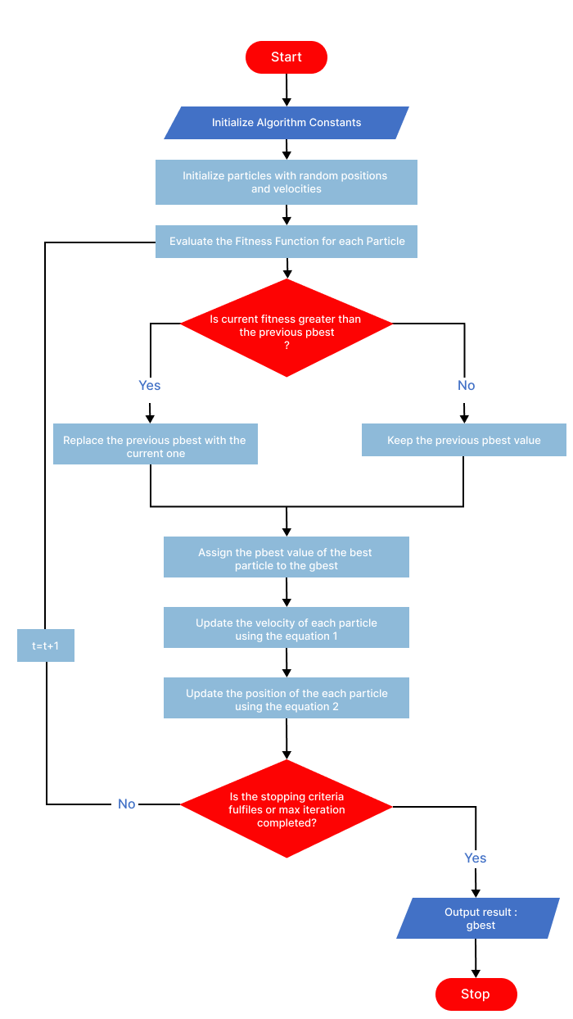
Concept of PSO Algorithm:
The Particle Swarm Optimization (PSO) algorithm is a metaheuristic optimization technique inspired by the social behavior of bird flocking or fish schooling.It involves a population of particles moving through the search space to find the optimal solution.
Each particle adjusts its position based on its own experience (personal best) and the collective knowledge of the swarm (global best).
Initialization
Evaluation
Update Personal Best
Update Global Best
Velocity Update
Position Update
Termination

Slide 8
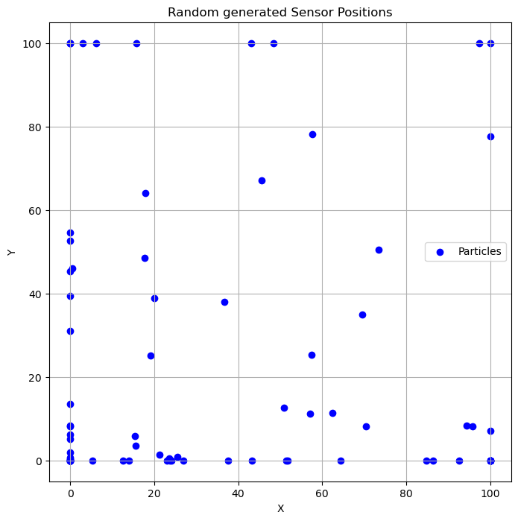
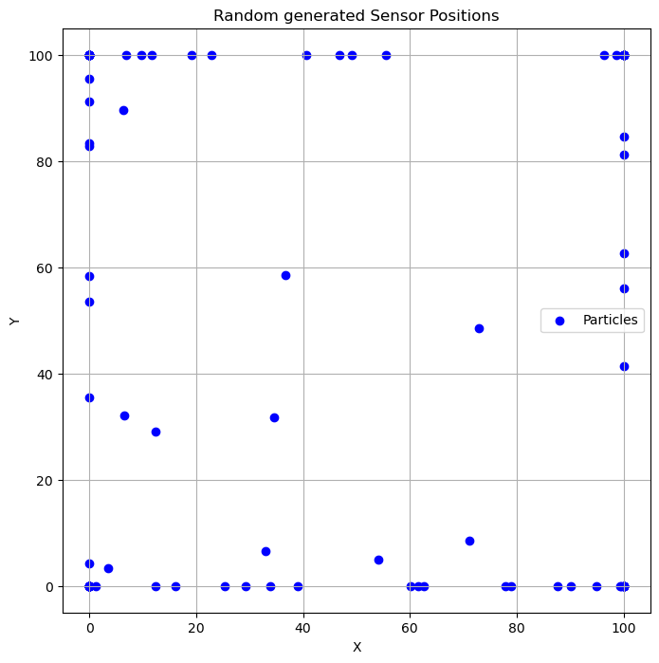
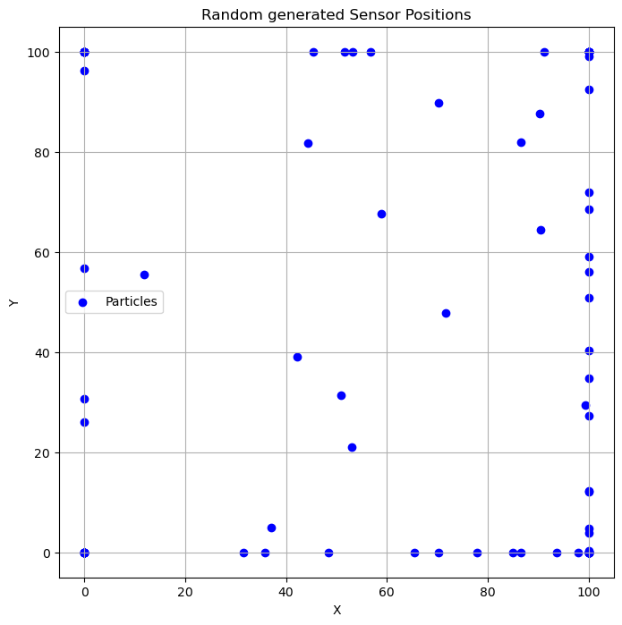
Implementation of PSO Algorithm:
The Particle Swarm Optimization (PSO) technique is employed to determine the optimal locations for sensors within a designated space.
The PSO algorithm utilizes a population of particles to represent potential sensor sites, with each particle having its own position in the space.
Initially, the positions of particles are randomly initialized within the specified boundaries of the region where sensors are to be deployed.

Slide 9
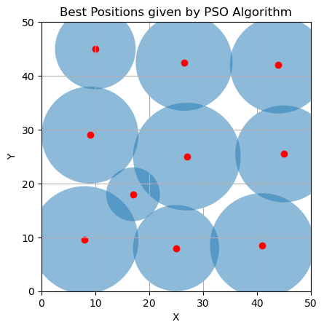
PSO Results :
Coordinates of sensors:
Sensor 1: (8, 9.5) ,10
Sensor 2: (25, 8) , 8
Sensor 3: (41, 8.5) ,9.7
Sensor 4: (27, 25) ,10
Sensor 5: (17, 18) ,5
Sensor 6: (26.5, 42.5) ,9
Sensor 7: (9, 29),9
Sensor 8: (10, 45),7.5
Sensor 9: (44, 42) ,9
Sensor 10: (45, 25.5) ,9
Total area of the region: 2500
Total area covered by circles: 2398.1033361912328
Total area uncovered by circles: 101.89666380876724
​

Slide 10
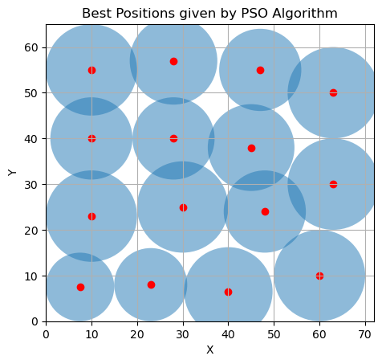
PSO Results :
No.of Sensors:15
Coordinates of sensors:
Sensor 1: (7.5, 7) ,7.5
Sensor 2: (23, 8) ,8
Sensor 3: (40, 6.5) ,9.7
Sensor 4: (30, 25) ,10
Sensor 5: (10, 23) ,10
Sensor 6: (28, 40) ,9
Sensor 7: (10, 40) ,9
Sensor 8: (10, 55) ,10
Sensor 9: (47, 55) ,9
Sensor 10: (48, 24) ,9
Sensor 11: (60, 10) ,10
Sensor 12: (45, 38) ,9.5
Sensor 13: (63, 30) ,10
Sensor 14: (63, 50) ,10
Sensor 15: (28, 57) ,9.6
Total area of the region: 4680
Total area covered by circles: 4403.7654
Total area uncovered by circles: 276.2346

Slide 11

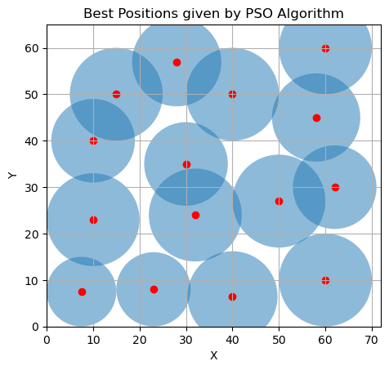
Results :
Conclusion:
Optimal Sensor Placements
Maximized Coverage Area
Efficient Resource Utilization
Improved Performance
Comparative Analysis
Visualization
Random coordinate generation
Radius tuning
PSO algorithm involvement
Maximizing coverage
Efficient resource utilization
Enhanced network performance

Slide 12
Advantages:
Applications :
Global Optimization
Fast Convergence
Flexibility
Ease of Implementation
Robustness
Parallelization
Environmental monitoring
Smart agriculture
Industrial IoT
Infrastructure monitoring
Disaster management
Wildlife tracking
Traffic management
Healthcare
Smart cities
Asset tracking

Slide 13
Resources:
Academic Journals
Research Papers.
Textbooks
Ali Norouzi, A. Halim Zaim, "Genetic Algorithm Application in Optimization of Wireless Sensor Networks", The Scientific World Journal, vol. 2014, Article ID 286575, 15 pages, 2014. https://doi.org/10.1155/2014/286575
Jin, Shiyuan, Ming Zhou, and Annie S. Wu. "Sensor network optimization using a genetic algorithm." Proceedings of the 7th world multiconference on systemics, cybernetics and informatics. 2003.

Slide 14
THANK YOU

